Slide 1
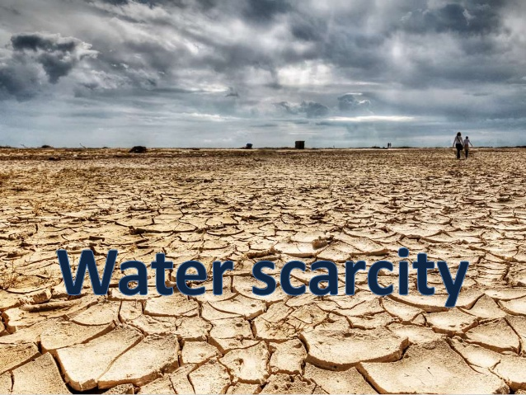
Knowledge checker
Year 8 – Summer Term
What do the following mean: water scarcity, water surplus, economic water scarcity and physical water scarcity?
Which part of the UK suffers the most water scarcity and why?
Explain 4 factors which influence the amount of water available?
What uses the most fresh water: industry, domestic or farming?
If you don’t have access to clean drinking water what problems will that cause?
Why would Egypt threaten Ethiopia with war over water?
When does water stress begin?
Give 3 invisible uses of water? And explain why water is needed in each example?
Which parts of the world are suffering the greatest water stress, can you give reasons?
Describe how a water transfer scheme works in the UK? What do they do differently in Oklahoma, USA?
What is grey water?
Describe three ways in which you could use water more sustainably?
Give 4 advantages of dams?
Give 4 disadvantages of dams?
Explain how a sand dam works?
This topic will teach you :
Water is a resource.
If we don’t use it carefully it will cause problems.
Some countries already face water insecurity.
There are methods we can use to increase the supply of water.
We can use water in more sustainable way.
Knowledge booklet

Slide 2
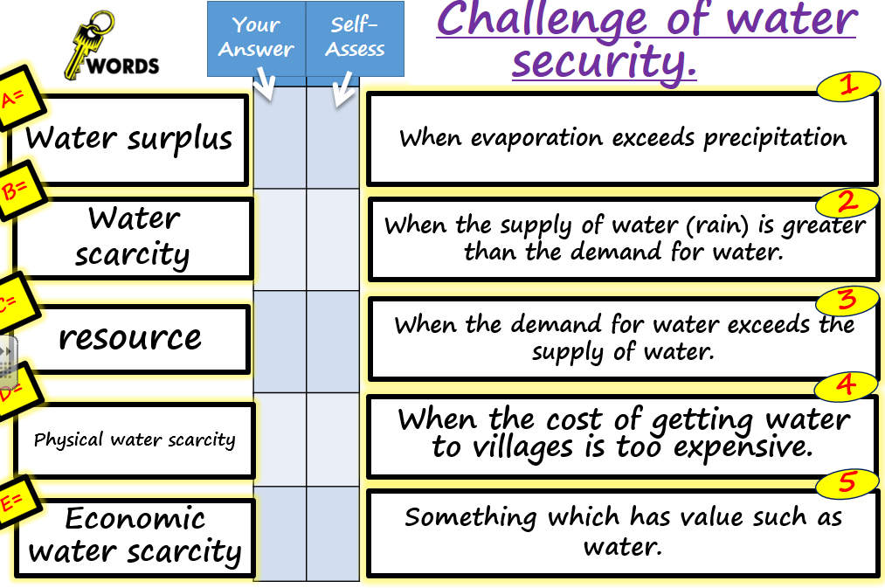
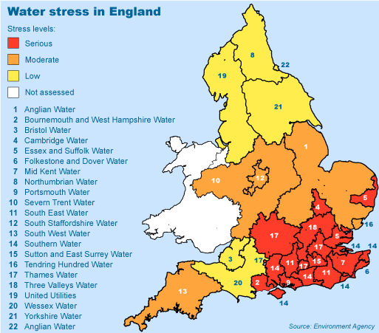
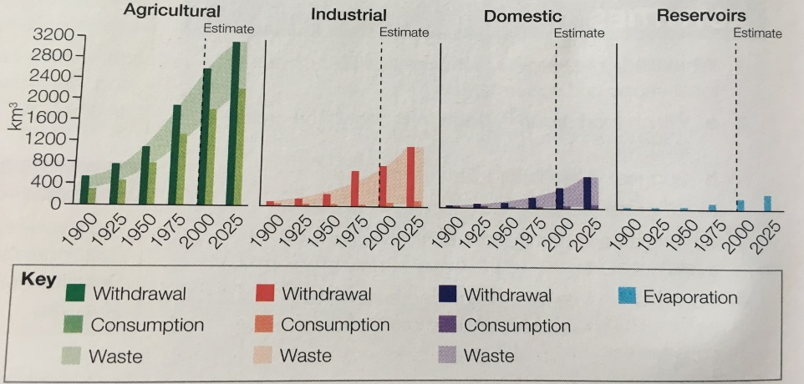
What does water security mean?
What factors influence water security
Water stress begins when countries experience less than 1700m3 of water available per person per year.
Describe the pattern of water stress in the UK and give 3 reasons to explain it.
Describe the changes in water consumption between 1900-2025

Slide 3
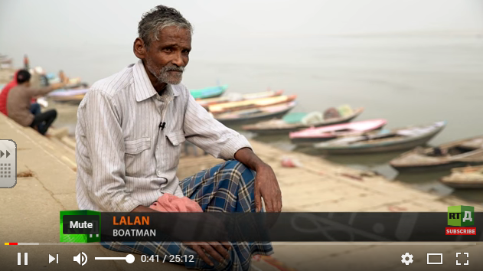
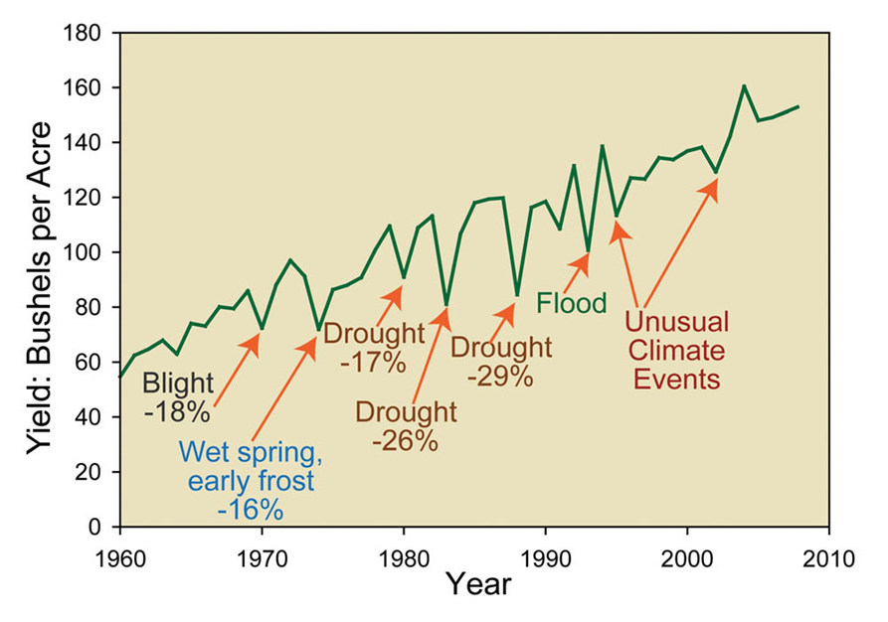
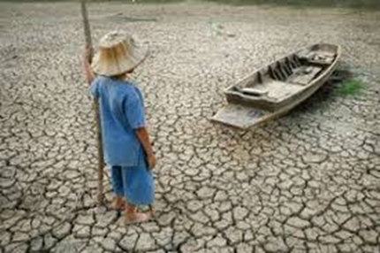
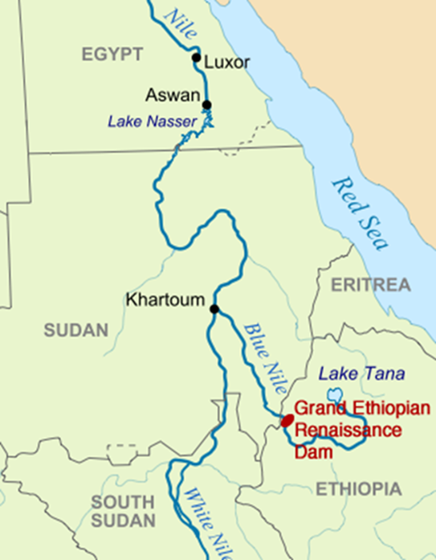
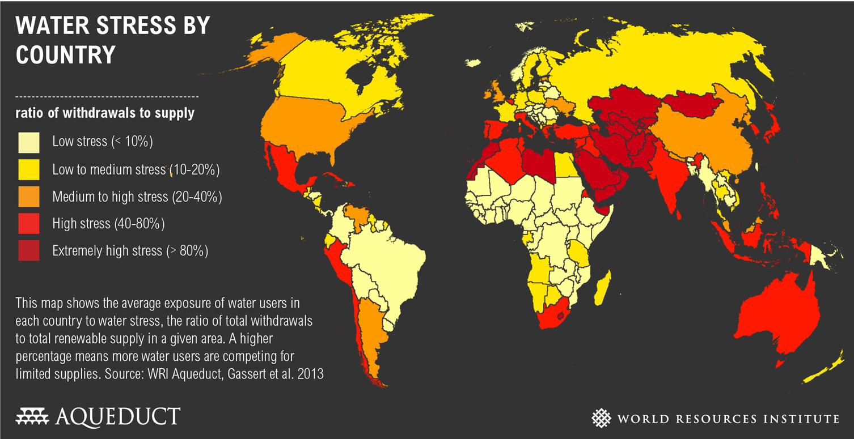
Impacts of water insecurity ?
Global Water Stress
Less than 1% of the worlds water is safe to drink, freshwater is often contaminated by sewage and industrial pollution. Some people are so poor they have no choice but to drink from these sources.
Water insecurity is when you cannot meet the water needs of your country due to physical or economic reasons.
https://www.youtube.com/watch?v=17DE2krqQMg
Impacts of lack of water on food supply – no water means dips in food production
Water stress begins when countries experience less than 1700m3 of water available per person per year.
Water is used in a number of invisible ways from the water needed to make a shirt, to making a cup of coffee.
A new dam on the Nile could trigger a war over water unless Ethiopia can agree a deal with Egypt and Sudan
Why is it so important to be able to have access to water for a country?
Describe the pattern of global water stress?

Slide 4
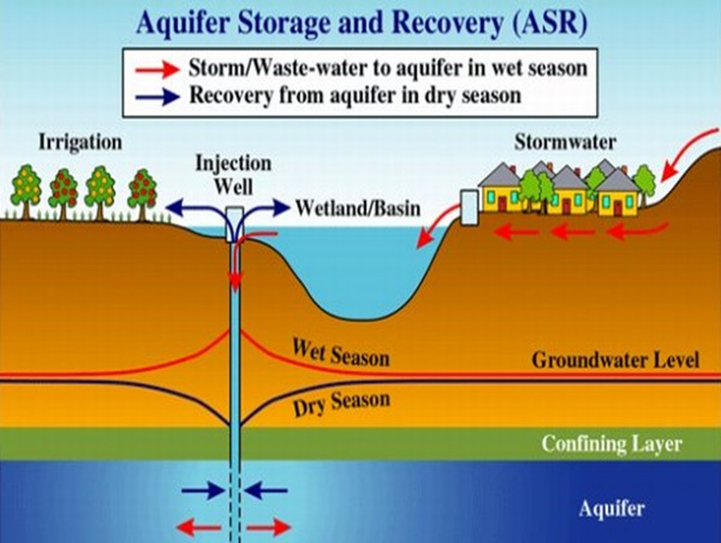
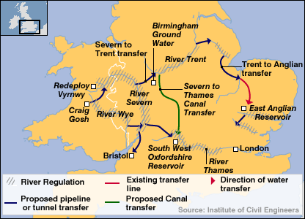
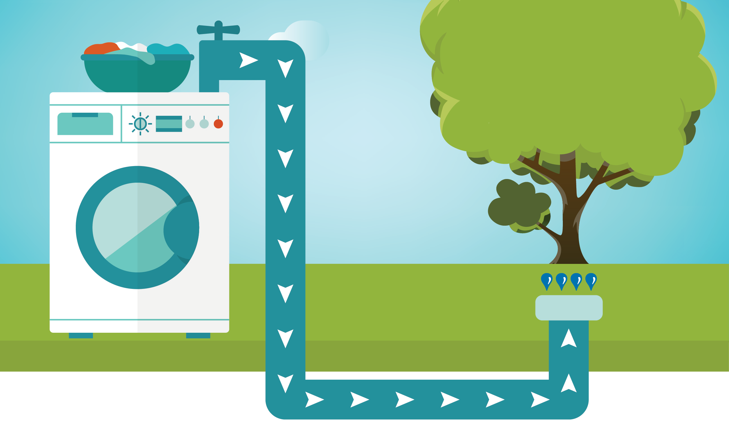
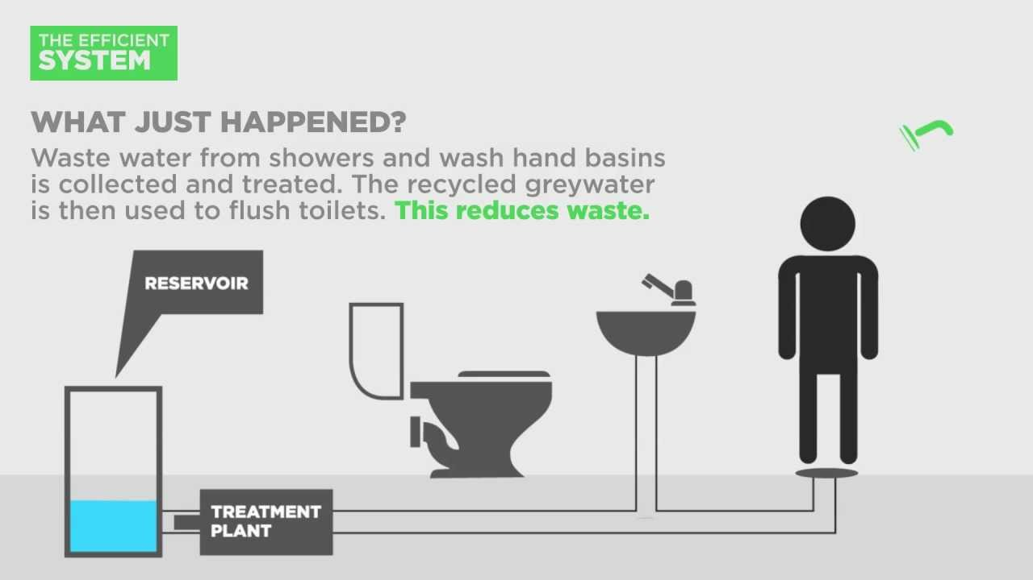
Strategies to Increase Water Supply?
Sustainable water supply
Some soils (e.g. Alluvium soil) have good water-holding capacity so water is forced deep underground before it can be evaporated it can be stored here, until its needed.
Water conservation is about trying to use less water.
Fixing leaks in pipes.
Fitting dual flush toilets.
Buying efficient washing machines which use less water.
Irrigate fields with drip pipes, rather than sprinkling methods which use more water .
Shower not bath.
Groundwater management
1. Monitor water levels beneath the ground.
2. Prevent pollution of ground water from fertiliser.
3. International agreements are needed when countries share access to ground water across borders.
Water transfer schemes in the UK move water from an area where there is water surplus to areas of water deficit (less water).
Grey Water
1. Filter shower and sink water to use on gardens and as toilet water.
2. Collect rainwater from your gutter and store it in a water but for use in the garden.
Kielder Reservoir is the largest reservoir in England – located in Northumberland. It supplies drinking water to Newcastle and Sunderland
Sustainable means making sure there is enough for today BUT without preventing future generation from having their own access to it
Do we need water transfer schemes?

Slide 5
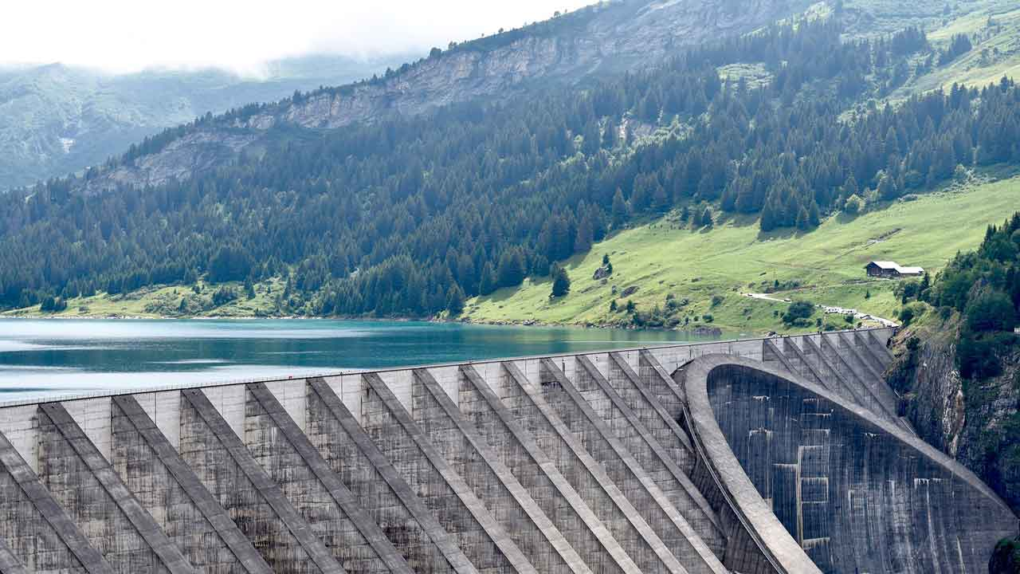
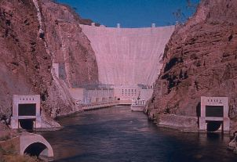
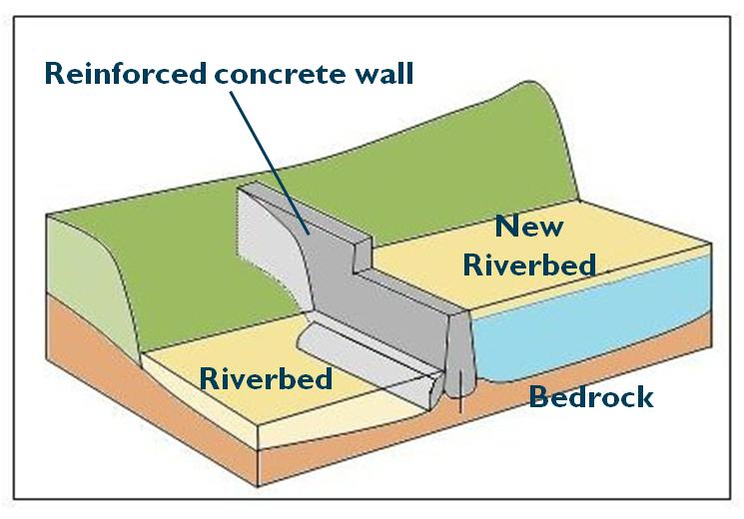
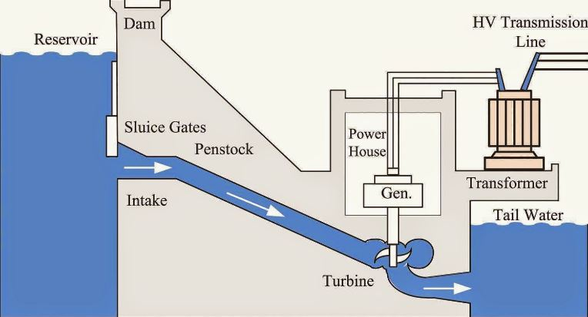
Advantage and disadvantages of dams and reservoirs
An example of a small scale sustainable water supply project in a LIC.
Kenya is a Low Income Country in east Africa, with a hot and dry climate. Most rain falls as heavy downpours, and quickly drains in to dry river beds and is evaporated or soaks in to the ground.
People in rural communities struggle to store water, but sand dams are a possible solution.
https://www.youtube.com/watch?v=YjzcfPax4As
Benefits of Dams & Reservoirs
Traps a large amount of water behind the dam
During heavy rainfall the reservoir will be filled, then water can be released when the water is needed, allowing a constant flow to the river all year round
Hydroelectricity can be produced
How does it work?
A concrete wall is dug in to the river bed as far down as the water table.
When it rains and the river flows, sand and water are trapped behind the concrete wall.
The sand traps/stores 1/3rd of the rainwater, and stops it being evaporated during the dry season.
When the river stops flowing water can be extracted from the sand by digging a well and piping it to the surface.
The dams are cheap and often use local materials.
Disadvantages of Dams & Reservoirs
Water is transferred along pipelines but includes building tunnels, aqueducts and pumping stations that are expensive to construct and maintain
Conflict can be caused if agricultural land is flooded during construction and settlements maybe drowned so people have to move and find new jobs
Name a dam in the UK and describe where it supplies water to?
Name three countries which border Kenya?

